Slide 1
Scala 3
David Hoepelman
13-04-2021
https://github.com/dhoepelman/xke-scala3 URL to presentation

Slide 2
Roadmap
Worked on since ~2014
2014-2016: DOT calculus 2015-2019: Dotty compiler 2020: Dotty renamed to Scala 3
2021-03: 3.0.0-RC2 released
Full release in 2021 (?)

Slide 3
Ecosystem
☑ Sbt 1.5.0 - 2021-04-03
☐ Scalafmt RC expected in 2020-04
☑ Scalatest 3.2.4 - 2021-02-19
☑ Cats 2.3.0 - 2020-11-26
☐ Akka
☐ Play
☑ IntelliJ 2020.1 - 2020-04-08 Still a tad shaky in my experience

Slide 4
What’s new
Syntax
Developer QoL
Compatibility between Scala versions
Type system advancements
Implicits redesigned: intent over mechanism
Meta-programming and macro’s redesigned

Slide 5
Syntax
In order from least to most controversial

Slide 6
Syntax
// import * is now the recommended alternative to import _ // Like basically all other languages import syntax._ import syntax.*
// ? is now the generic wildcard instead of _ // Like basically all other languages val list1: List[_] = List.empty val list2: List[?] = List()

Slide 7
Syntax
// new is now optional // Like: Kotlin val dogNew = new Dog("Fluffy") val dog = Dog("Fluffy")
// Because all classes have generated apply() methods like case classes class Dog(val name: String) val dogApply = Dog.apply("1")

Slide 8
Syntax
// variable and function declarations can now be top-level // package object is now unnecessary and deprecated
val x = 0 def foo(): Unit = {} def bar(): Unit = {}

Slide 9
Syntax
// Braces and brackets are always optional
// Scala 2 & 3
for {
p <- products
if p.category == "Fruit"
} yield p
// Scala 3
for
p <- products
if p.category == "Fruit"
yield p
// Scala 2 & 3
if(x < 0) {
foo()
} else {
bar()
}
// Scala 3
if x < 0 then
foo()
else
bar()

Slide 10
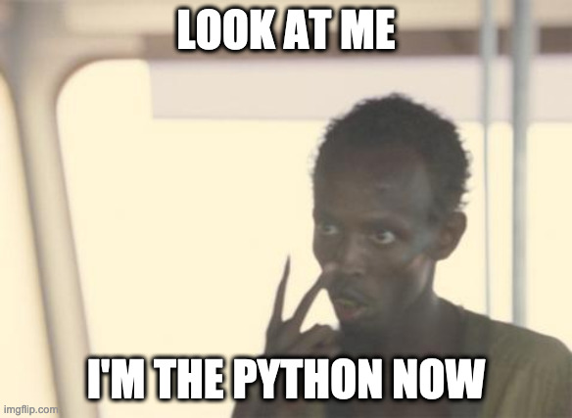
Syntax
Whitespace syntax
Very controversial change: https://contributors.scala-lang.org/t/feedback-sought-optional-braces/4702

Slide 11
Syntax
Whitespace syntax
class BracesDog(name: String) extends Animal {
val coatColor = "Brown"
def bark() = println("Woof")
}
val bracesMatch = either() match {
case Left(x) => true
case Right(x) => false
}
class WhitespaceDog(name: String) extends Animal:
val coatColor = "Brown"
def bark() = println("Woof")
val whitespaceMatch = either() match
case Left(x) => true
case Right(x) => false

Slide 12
Enumerations
enum Color(val name: String) { case Red extends Color("Red") case Blue extends Color("Blue") case Green extends Color("Green") } // List elements val values: Array[Color] = Color.values // Name to element val red: Color = Color.valueOf("Red") // Exhaustive matching println(red match { case Color.Red => "It's red!" case Color.Blue => "It's blue!" case Color.Green => "It's green!" }) // They can be made a java-compatible enum enum JavaCompatible(val x: String) extends Enum[JavaCompatible] { case Member extends JavaCompatible("x") }

Slide 13
Language features
// Union types // Dual of intersection types
type MyEither[L, R] = L | R
// Intersection is the dual, already exists in "extends ... with ..." type CanSerialize[T] = T & Serializable
// with is now an alias for intersection, but available because order can matter trait Base trait Sub extends Base with Serializable // with is normalized to & val x: Base & Serializable = new Sub {}

Slide 14
Language features
// Union types // Dual of intersection types
type MyEither[L, R] = L | R
// Intersection is the dual, already exists in "extends ... with ..." type CanSerialize[T] = T & Serializable
// with is now an alias for intersection, but available because order can matter trait Base trait Sub extends Base with Serializable // with is normalized to & val x: Base & Serializable = new Sub {}

Slide 15
Language features
// However, it is not as smart as e.g. Typescript by far. This will not compile.
// Typescript can do things like this val result: Int | "INTERNAL_SERVER_ERROR" = 1 def process[T : ClassTag](result: T | "INTERNAL_SERVER_ERROR"): T = { result match { case "INTERNAL_SERVER_ERROR" => throw new Exception("Uh oh") case t: T => t } } val y: Int = process(result)

Slide 16
Language features
// Explicit nulls
// Compile error if -Yexplicit-nulls is added // val notnull: String = null
// union types to the rescue val nullable: String | Null = null

Slide 17
Implicits
Powerful
Unique to scala
Difficult to grok
Low level, overloaded

Slide 18
Implicits
Currently used for
Extension methods
Implicit conversion
Typeclasses
Type-level programming
Dependency injection
…
Scala 3 goal: “Intent over mechanism”

Slide 19
Implicit replacement: Extensions
// Extension functions trait Animal case class Dog(name: String) extends Animal
extension (doggo: Dog) def bark1(): Unit = println("woof") extension [T <: Animal](animal: T) def walk(): Unit = println("walk")
// Old syntax: implicit class DogExtensions(val doggo: Dog) extends AnyVal { def bark2(): Unit = println("woof") } val woof1 = Dog("1").bark1() val woof2 = Dog("2").bark2() val woof3 = Dog("3").walk()

Slide 20
Implicit replacement: Conversions
case class MyString(val s: String) val a: MyString = { import scala.language.implicitConversions given Conversion[String, MyString] with def apply(str: String): MyString = MyString(str) "A" }
val b: MyString = { import scala.language.implicitConversions // old syntax implicit def stringToMyString(s: String): MyString = MyString(s) "b" }

Slide 21
Implicit replacement: given and using
trait ToJson[T] { def toJson(t: T): String } given jsonInt: ToJson[Int] with { override def toJson(t: Int): String = t.toString } given jsonMap[T] (using toJson: ToJson[T]): ToJson[Map[String, T]] with { override def toJson(map: Map[String, T]): String = map .map( (k, v) => s""""${k}" : ${toJson.toJson(v)}""" ) .mkString("{\n", ",\n", "\n}") } def makeJson[T](value:T)(using toJson: ToJson[T]): String = toJson.toJson(value)
makeJson(Map("a" -> 1, "b" -> 2))

Slide 22
Meta-programming
Totally redesigned
Inline
Compile-time operations
Quasi-quotes
Tasty: Scala AST for reflection

Slide 23
Compatibility
We’re totally prepared for the Python 3 Scala 3 migration
All* Scala 2.13 code is valid Scala 3
Scala 3 can use 2.13 libraries
Scala 2.13.5 can use Scala 3 libraries (depending on features used)
Plan: All Scala 3.x versions can use all 3.x libraries

Slide 24
Compatibility
View bounds and some other esoteric constructs: gone
Macro’s: uh-oh
Scala 2 macro’s are Scala 2 compiler Scala 3 macro’s are TASTY

Slide 25
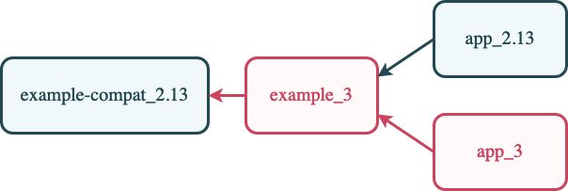
Compatibility
View bounds and some other esoteric constructs: gone
Macro’s: uh-oh
Scala 2 macro’s are Scala 2 compiler Scala 3 macro’s are TASTY
Solution: define Scala 2 & 3 macro’s in single artifact

Slide 26
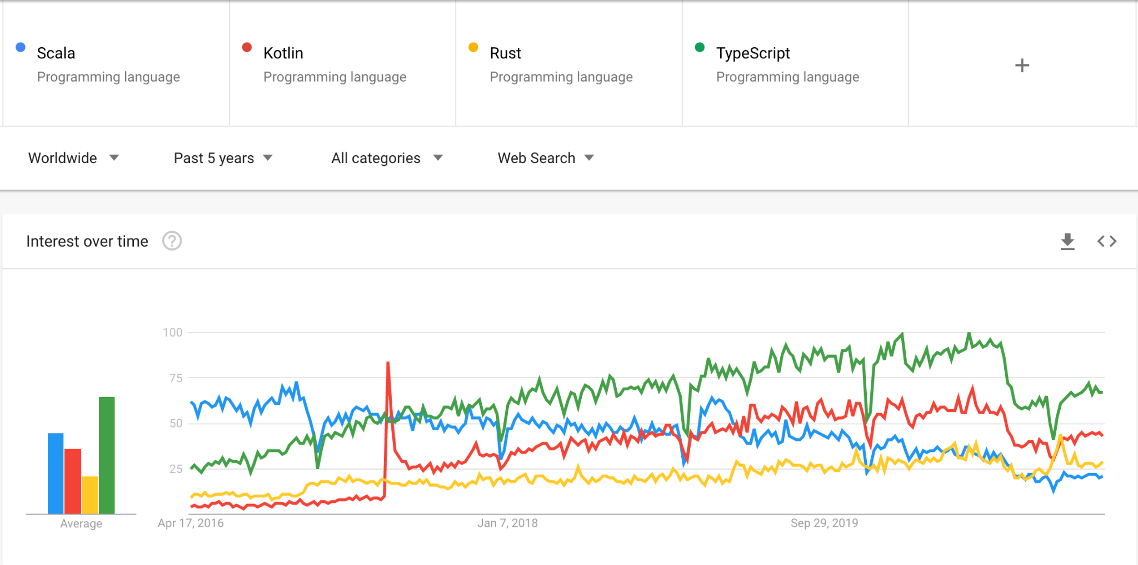
Discussion
Changes
Migration
State of Scala

